Slide 1
Front End Engineering-I Project
BookMySpot – Movie Booking Website
Team Details:
Jobanpreet Singh Gill – 2410990369
Kabirjeet Singh – 2410990370
Kanika Aggarwal – 2410990371
Faculty Coordinator:
Dr. Mohammad Shuaib Khan
:
Chitkara University Institute of Engineering and Technology,
Chitkara University, Punjab

Slide 2
Table of Contents
Introduction
Problem Statement
Technical Details
Key Features
Project Highlights
Bonus Feature(optional)
Conclusion
References/Links used

Slide 3
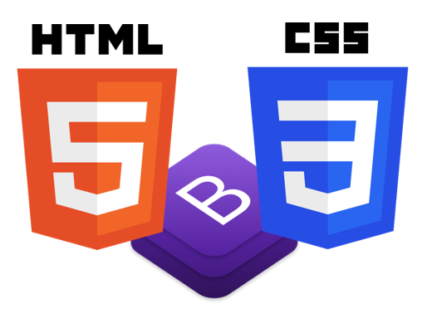

Introduction
BookMySpot
Front End-
HTML
Bootstrap
CSS
Back End-
FLASK
JavaScript

Slide 4
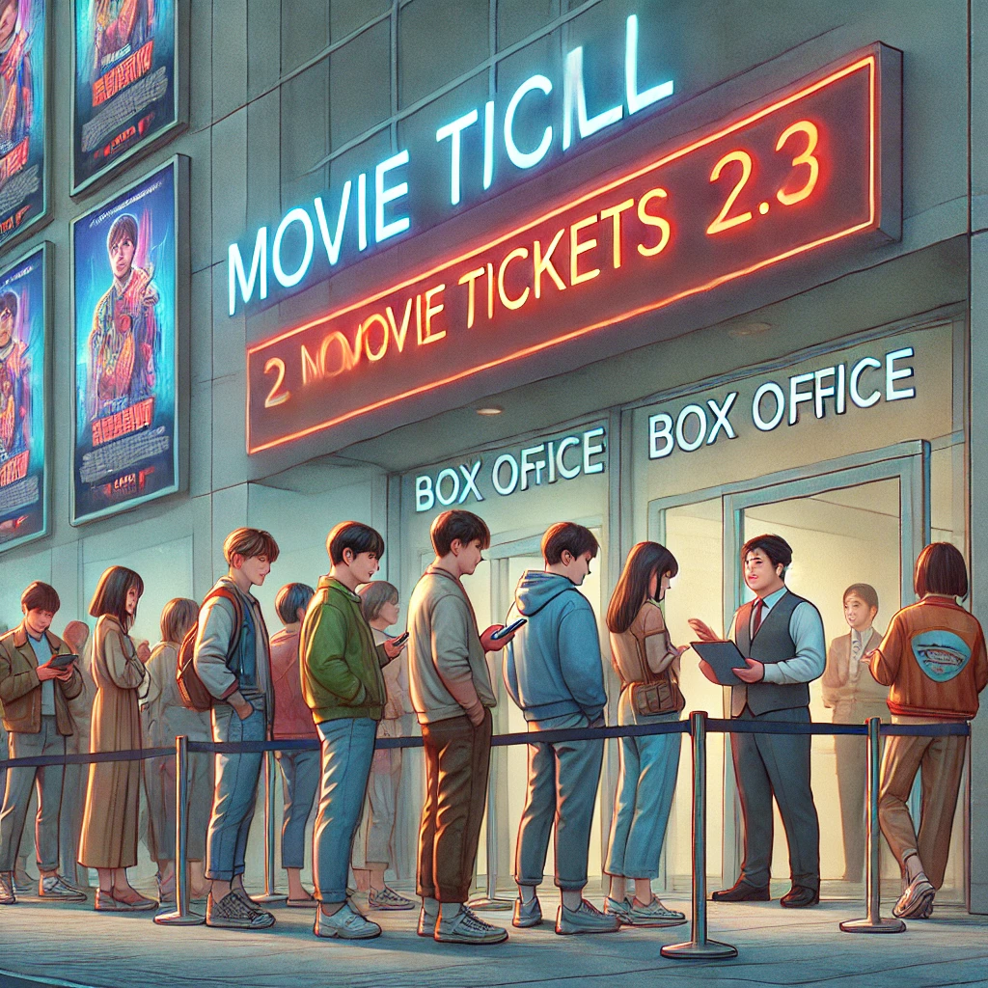
Problem Statement
Traditional methods of booking movie tickets are outdated, and many online platforms are cumbersome or not mobile-friendly. There’s a need for a lightweight, user-friendly, and responsive online booking platform that ensures a seamless experience for users while being simple enough for small cinemas to manage efficiently.
It is an AI generated Image – Generated by OpenAI’s Dall-E 3 Model

Slide 5
Technical Details
The BookMySpot movie booking website uses Bootstrap for responsive front-end design and Flask for flexible back-end development, enabling efficient user authentication. Jinja integrates dynamic content within HTML templates, ensuring a seamless, interactive user experience across mobile and desktop platforms.

Slide 6
Key Features
User Authentication
Forgot Password with OTP verification
Sign-up/ Login
Password Encryption
Backend Server Communication
Responsive Design

Slide 7
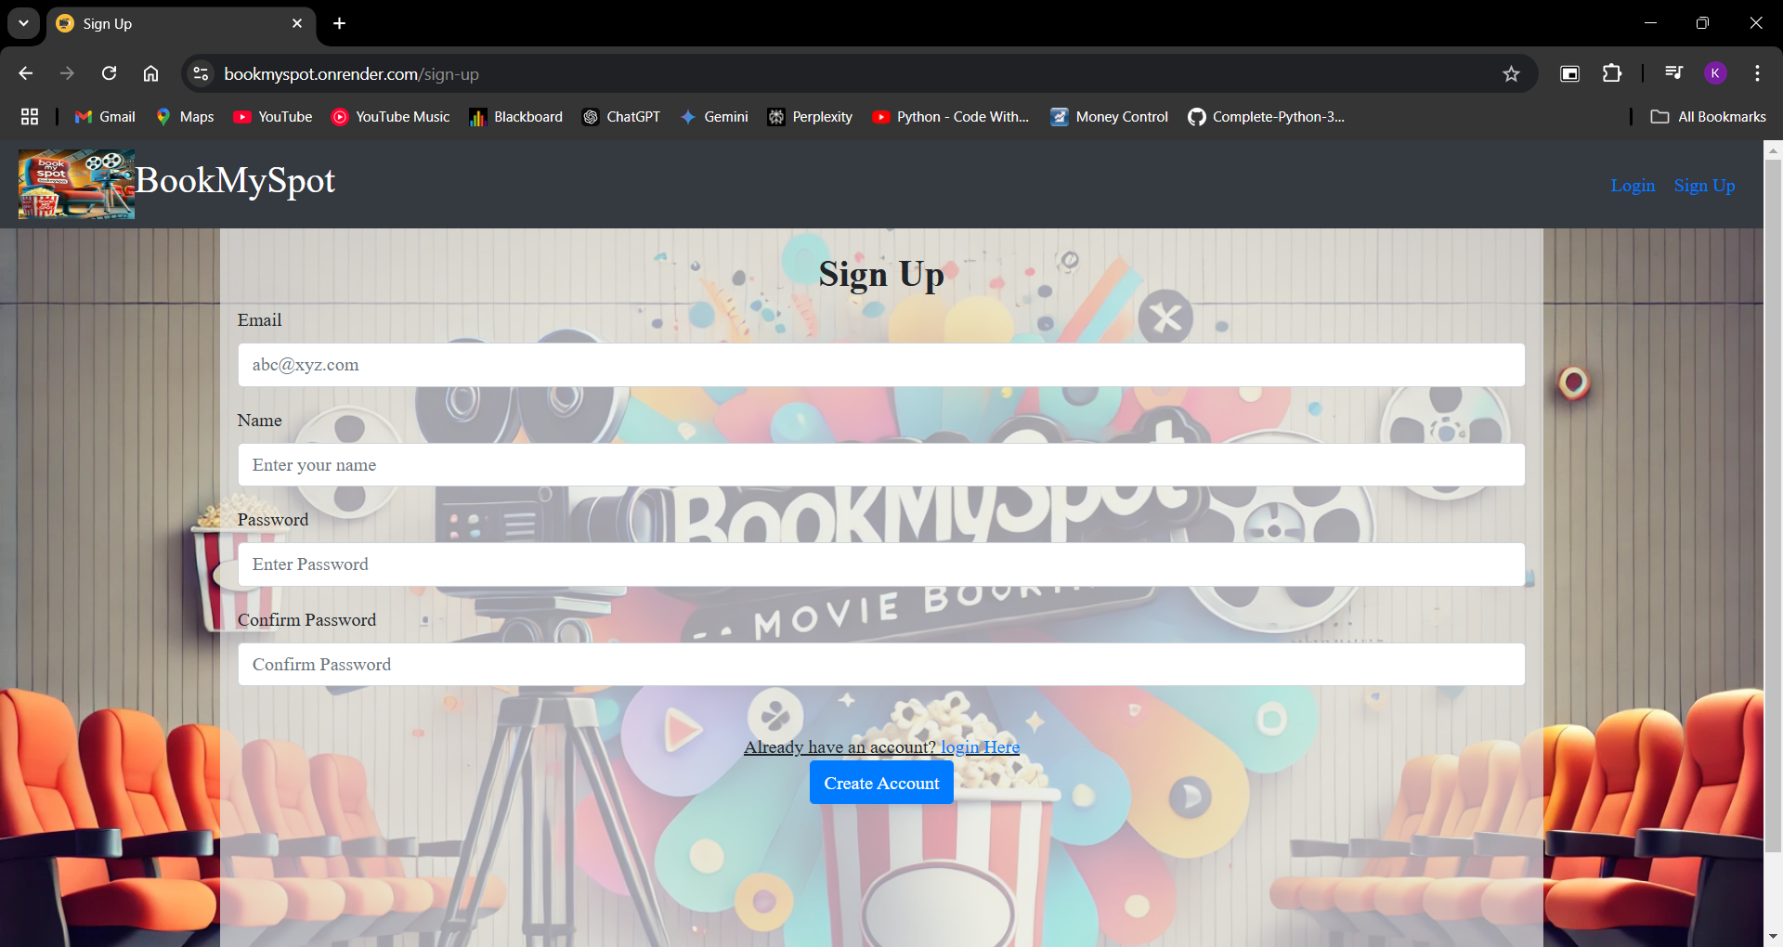
Project Highlights

Slide 8
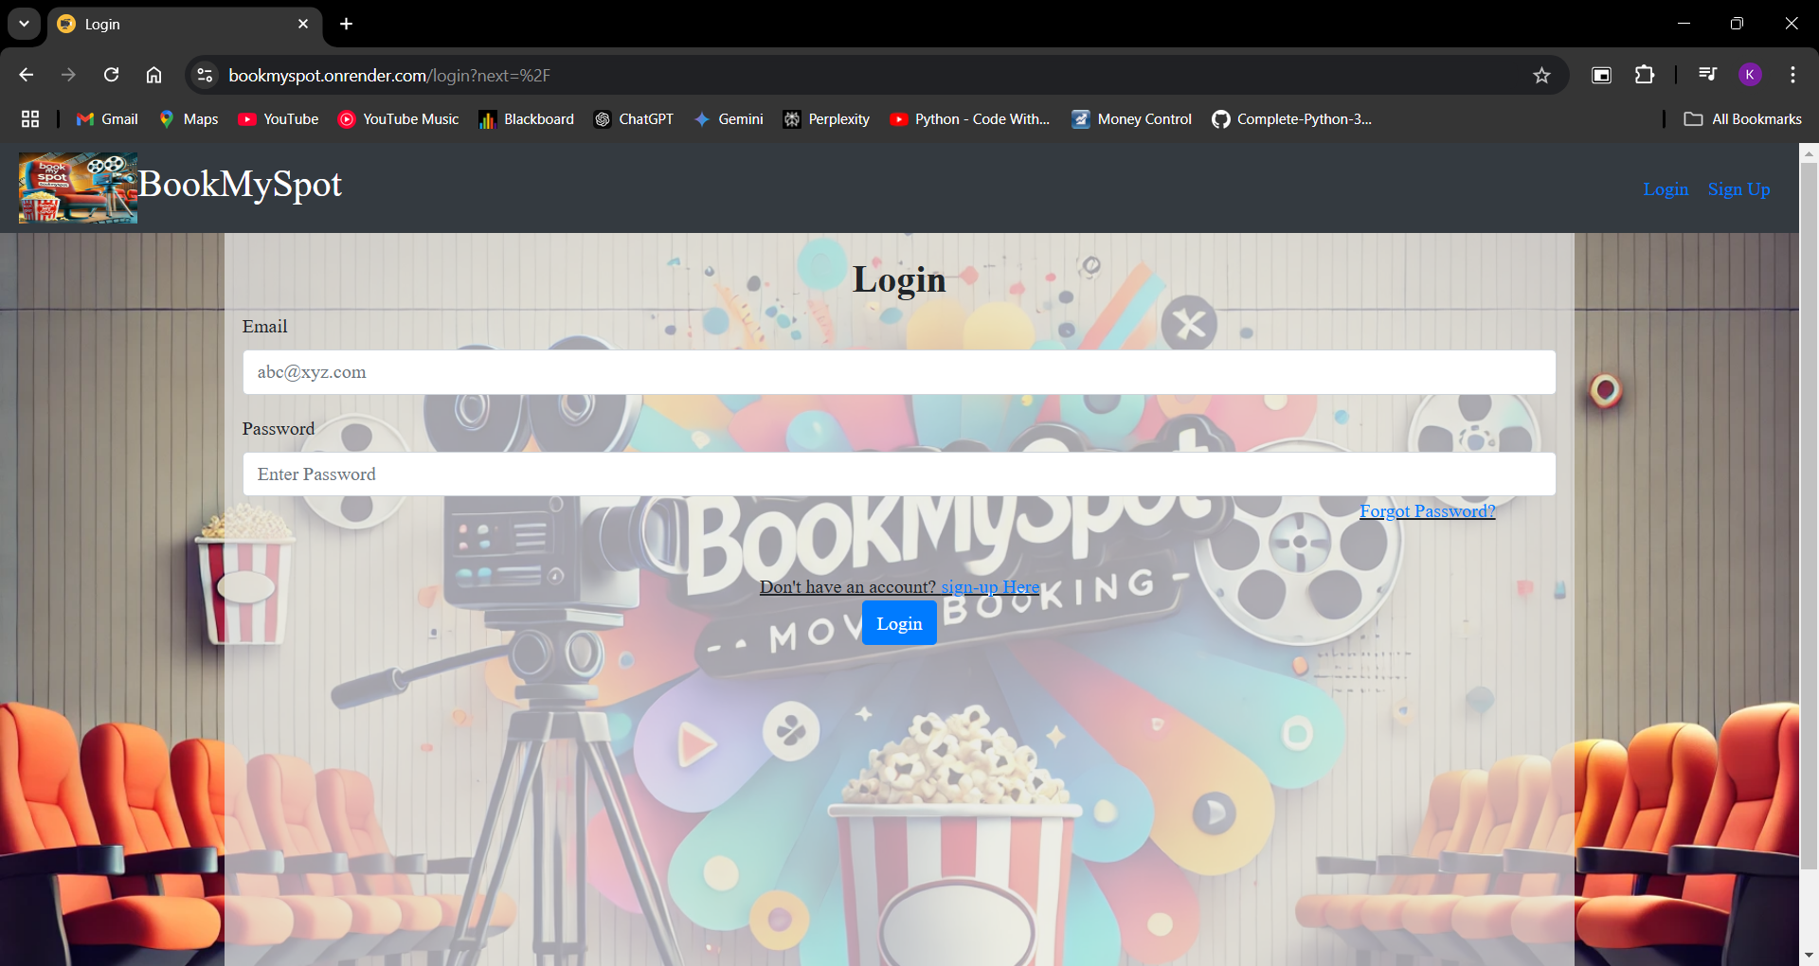
Project Highlights

Slide 9
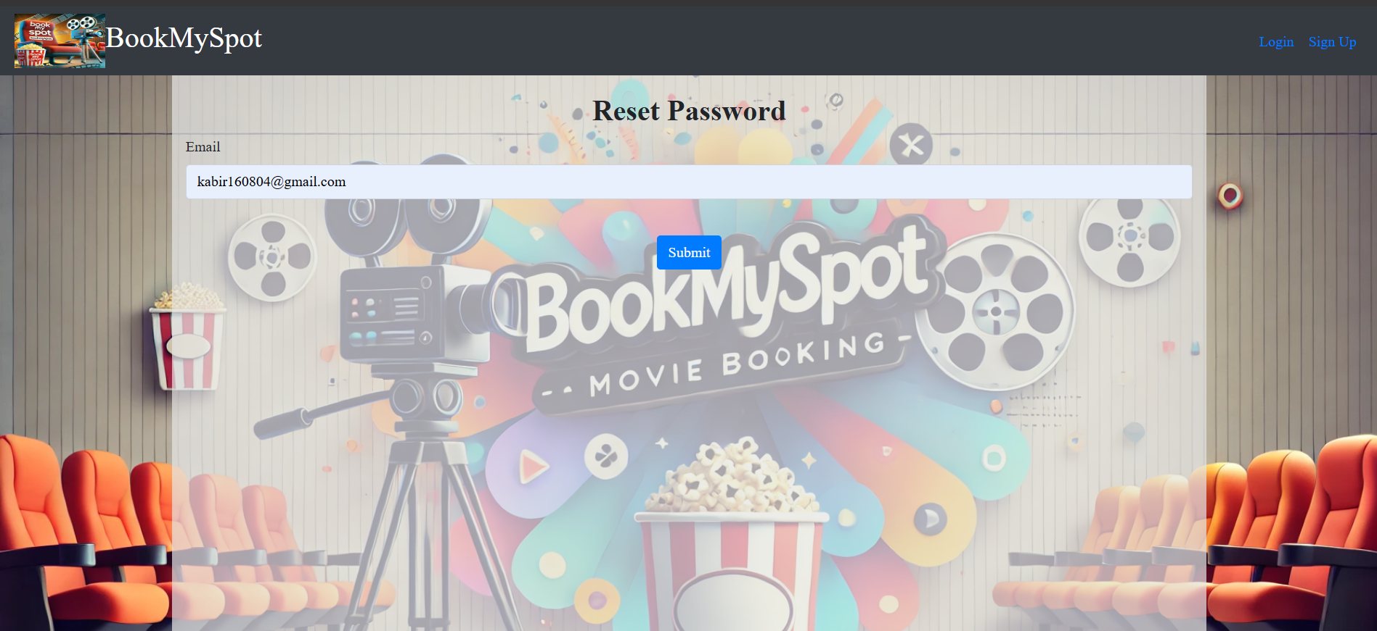
Project Highlights

Slide 10
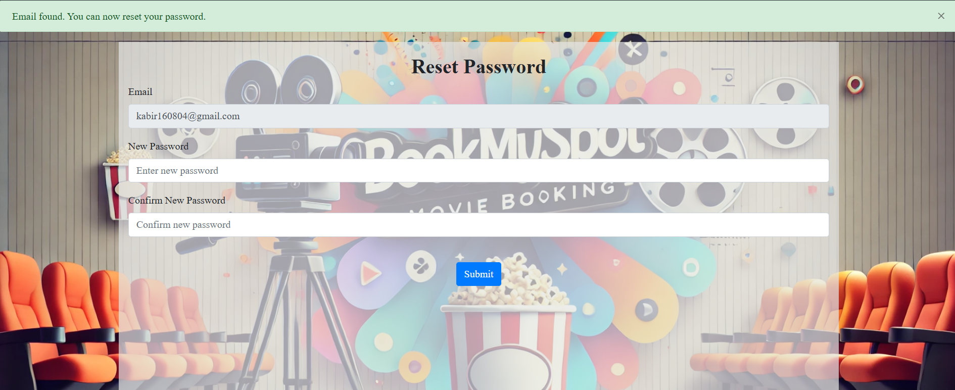
Project Highlights

Slide 11
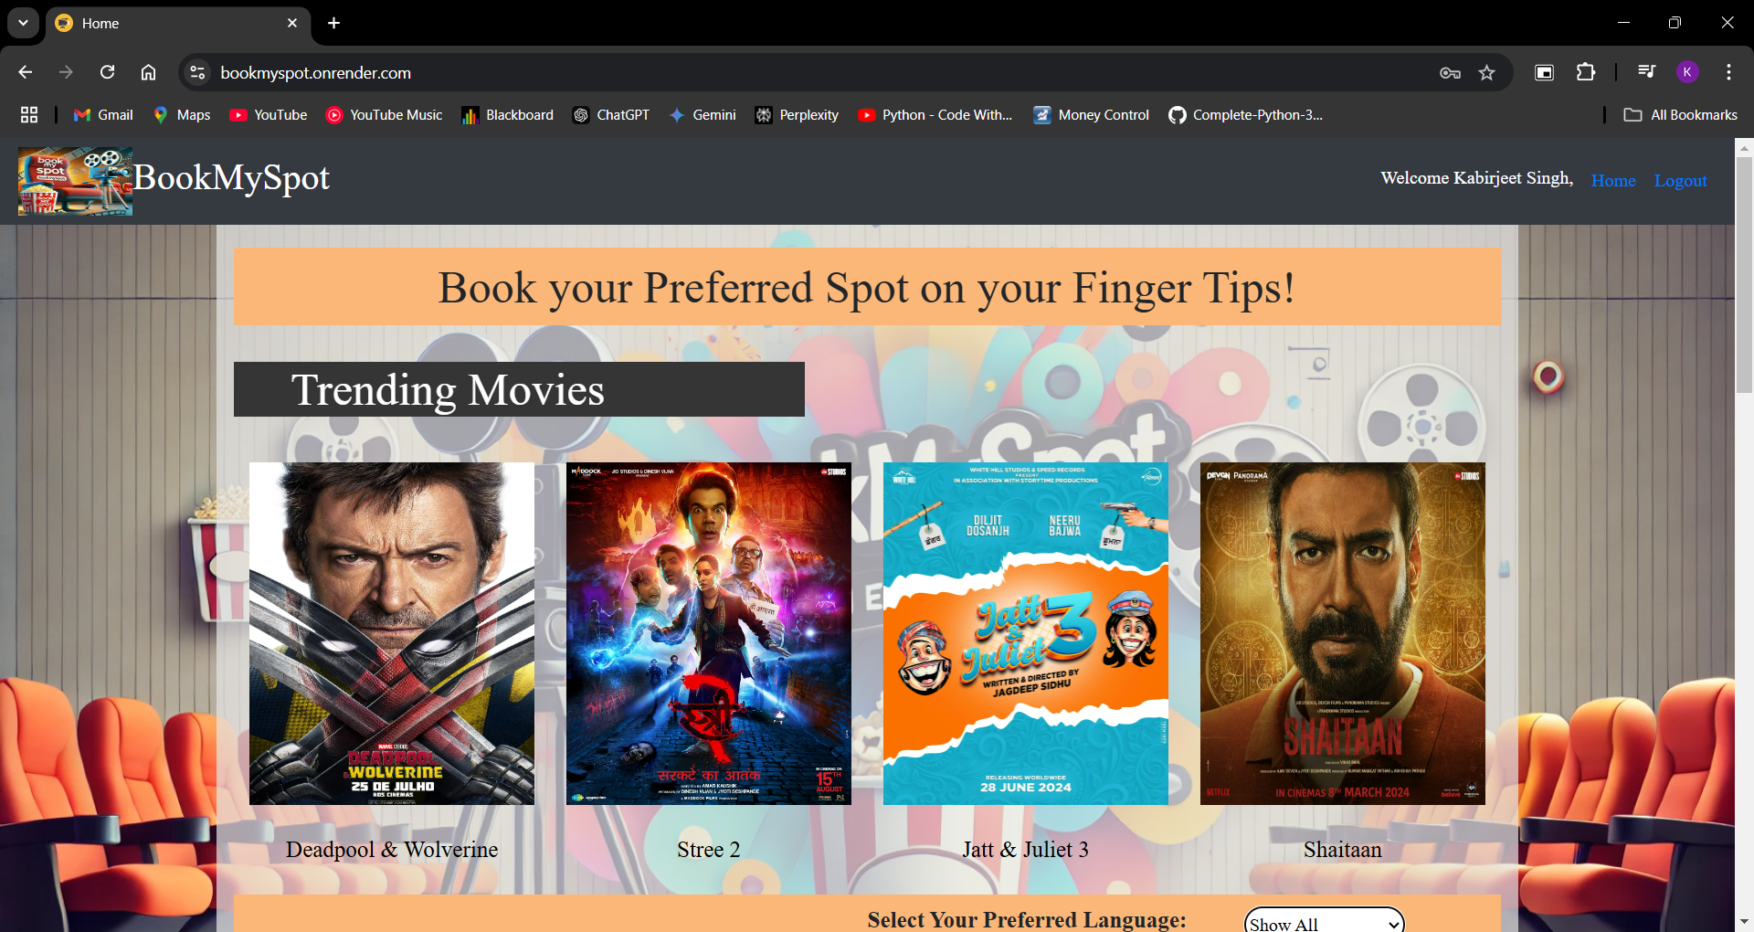
Project Highlights

Slide 12
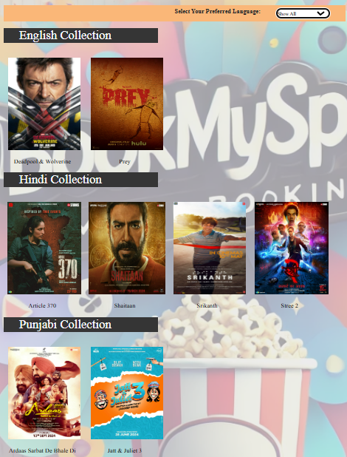

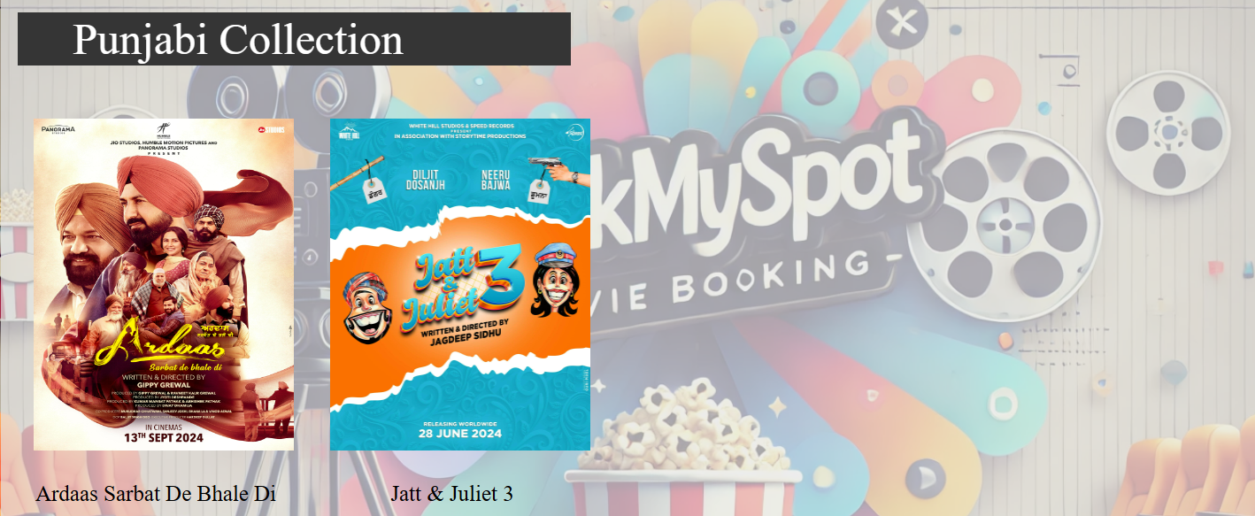
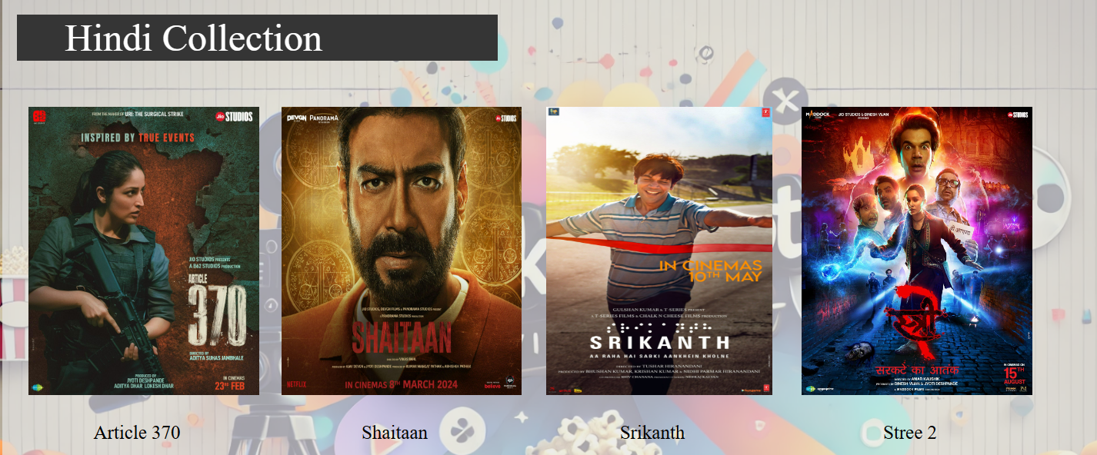
Project Highlights

Slide 13
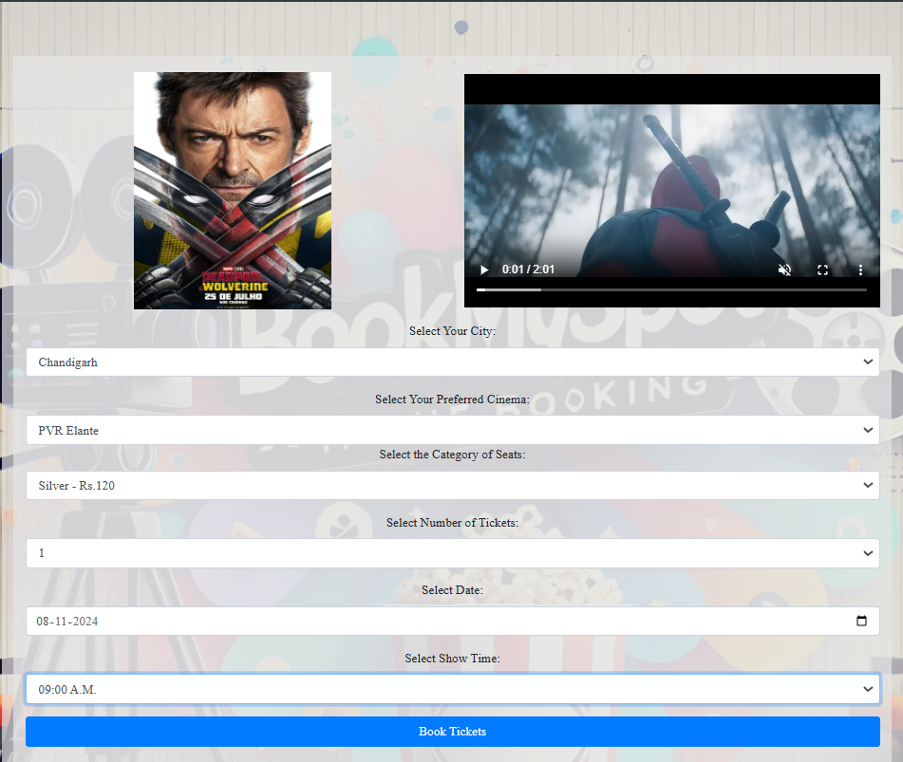
Project Highlights

Slide 14
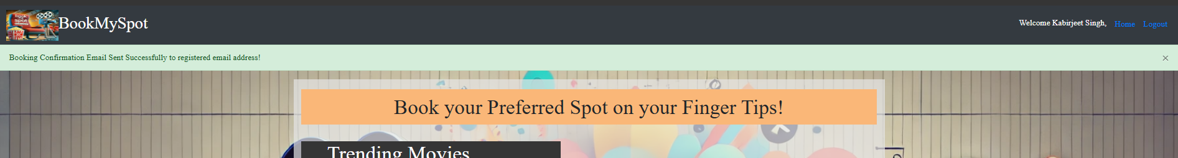
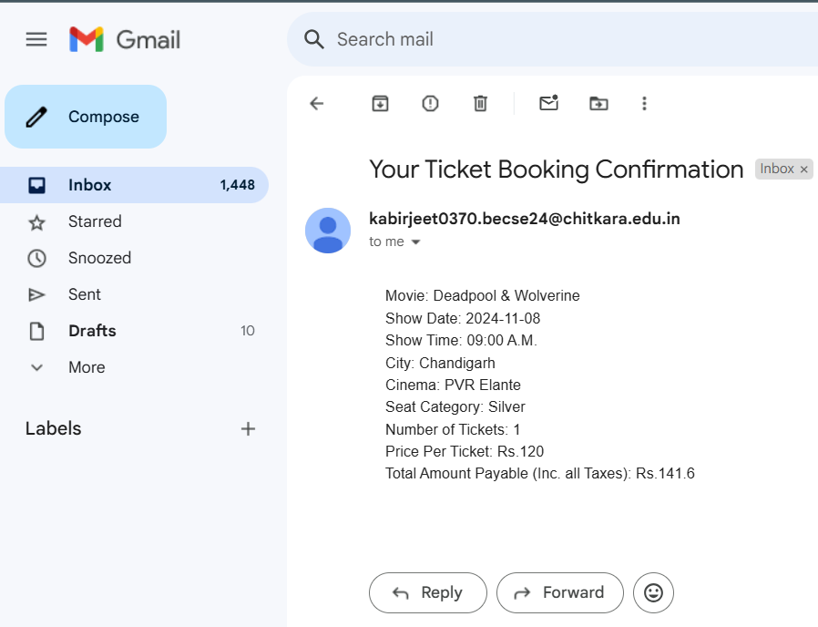
Project Highlights
Booking Confirmation Sent to Email Address.
Email Confirmation

Slide 15
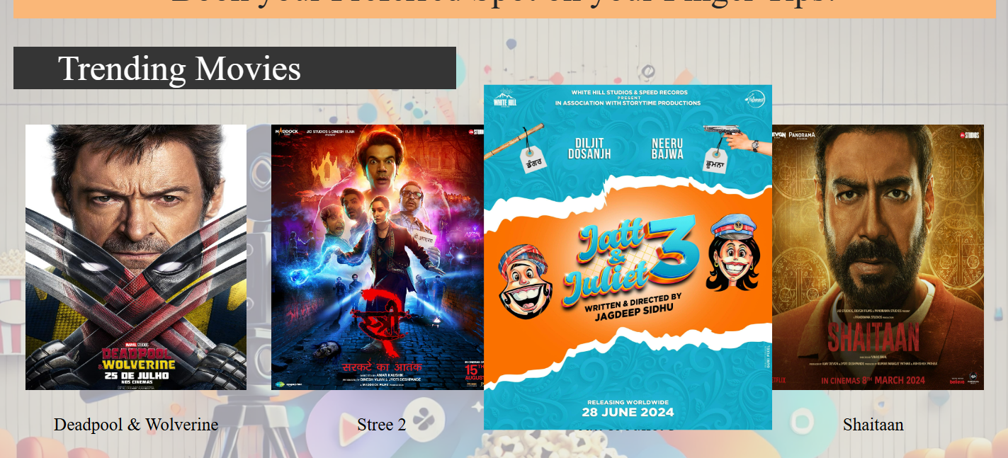
Project Highlights
Hover Animation

Slide 16
Conclusion
The Project offers a modern ticketing solution with Bootstrap for responsive design and Flask for back-end functionality. Users can securely log in, browse, and book tickets with ease. Its user-friendly interface and dynamic content streamline cinema operations and enhance customer satisfaction across all devices.
While working on this project, we got an opportunity to learn about new concepts such as Flask.

Slide 17
References/Links used
Tech With Tim. (2021, February 1). Python website full tutorial - flask, authentication, databases & more [Video]. YouTube. https://www.youtube.com/watch?v=dam0GPOAvVI
Ved The Master. (2021, August 10). How to upload files/folders/projects on github | Upload Project folder on github (Simple Way) [Video]. YouTube. https://www.youtube.com/watch?v=eGaImwD8fPQ
W3Schools.com. (n.d.). https://www.w3schools.com/bootstrap/bootstrap_ref_all_classes.asp

Slide 18
Website Online Link
BookMySpot Online Link to be accessed on any device anytime:
https://bookmyspot.onrender.com/

Slide 19


